Slide 1
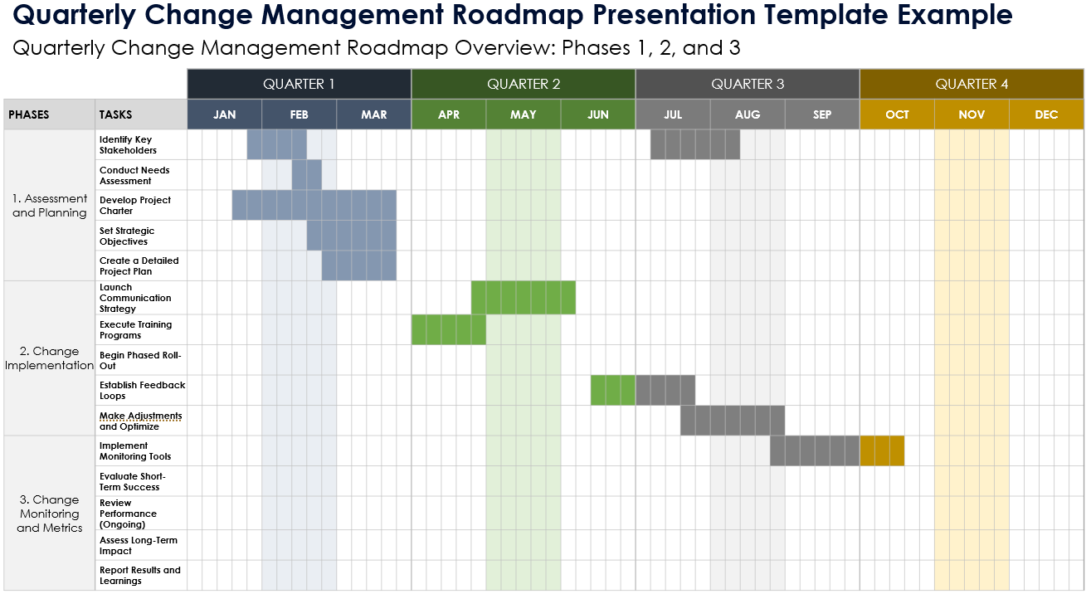
Quarterly Change Management Roadmap Presentation Template

Slide 2
Quarterly Change Management Roadmap Overview: Phases 1, 2, and 3
 |  | QUARTER 1 |  |  |  |  |  |  |  |  |  |  |  |  |  |  | QUARTER 2 |  |  |  |  |  |  |  |  |  |  |  |  |  |  | QUARTER 3 |  |  |  |  |  |  |  |  |  |  |  |  |  |  | QUARTER 4
PHASES | TASKS | JAN |  |  |  |  | FEB |  |  |  |  | MAR |  |  |  |  | APR |  |  |  |  | MAY |  |  |  |  | JUN |  |  |  |  | JUL |  |  |  |  | AUG |  |  |  |  | SEP |  |  |  |  | OCT |  |  |  |  | NOV |  |  |  |  | DEC
1. Phase 1 Name | Task Name
2. Phase 2 Name | Task Name
3. Phase 3 Name | Task Name

Slide 3
Roadmap Overview: Phase 1
 |  | QUARTER 1 |  |  |  |  |  |  |  |  |  |  |  |  |  |  | QUARTER 2 |  |  |  |  |  |  |  |  |  |  |  |  |  |  | QUARTER 3 |  |  |  |  |  |  |  |  |  |  |  |  |  |  | QUARTER 4
PHASE 1 | TASKS | JAN |  |  |  |  | FEB |  |  |  |  | MAR |  |  |  |  | APR |  |  |  |  | MAY |  |  |  |  | JUN |  |  |  |  | JUL |  |  |  |  | AUG |  |  |  |  | SEP |  |  |  |  | OCT |  |  |  |  | NOV |  |  |  |  | DEC
1. Phase 1 Name | Task Name: Brief Description.
 | Task Name: Brief Description.
 | Task Name: Brief Description.
 | Task Name: Brief Description.
 | Task Name: Brief Description.

Slide 4
Roadmap Overview: Phase 2
 |  | QUARTER 1 |  |  |  |  |  |  |  |  |  |  |  |  |  |  | QUARTER 2 |  |  |  |  |  |  |  |  |  |  |  |  |  |  | QUARTER 3 |  |  |  |  |  |  |  |  |  |  |  |  |  |  | QUARTER 4
PHASE 2 | TASKS | JAN |  |  |  |  | FEB |  |  |  |  | MAR |  |  |  |  | APR |  |  |  |  | MAY |  |  |  |  | JUN |  |  |  |  | JUL |  |  |  |  | AUG |  |  |  |  | SEP |  |  |  |  | OCT |  |  |  |  | NOV |  |  |  |  | DEC
2. Phase 2 Name | Task Name: Brief Description.
 | Task Name: Brief Description.
 | Task Name: Brief Description.
 | Task Name: Brief Description.
 | Task Name: Brief Description.

Slide 5
Roadmap Overview: Phase 3
 |  | QUARTER 1 |  |  |  |  |  |  |  |  |  |  |  |  |  |  | QUARTER 2 |  |  |  |  |  |  |  |  |  |  |  |  |  |  | QUARTER 3 |  |  |  |  |  |  |  |  |  |  |  |  |  |  | QUARTER 4
PHASE 3 | TASKS | JAN |  |  |  |  | FEB |  |  |  |  | MAR |  |  |  |  | APR |  |  |  |  | MAY |  |  |  |  | JUN |  |  |  |  | JUL |  |  |  |  | AUG |  |  |  |  | SEP |  |  |  |  | OCT |  |  |  |  | NOV |  |  |  |  | DEC
3. Phase 3 Name | Task Name: Brief Description.
 | Task Name: Brief Description.
 | Task Name: Brief Description.
 | Task Name: Brief Description.
 | Task Name: Brief Description.

Slide 6
NOTES
Summary Information / Comments

Slide 7
DISCLAIMER Any articles, templates, or information provided by Smartsheet on the website are for reference only. While we strive to keep the information up to date and correct, we make no representations or warranties of any kind, express or implied, about the completeness, accuracy, reliability, suitability, or availability with respect to the website or the information, articles, templates, or related graphics contained on the website. Any reliance you place on such information is therefore strictly at your own risk.

