Slide 1
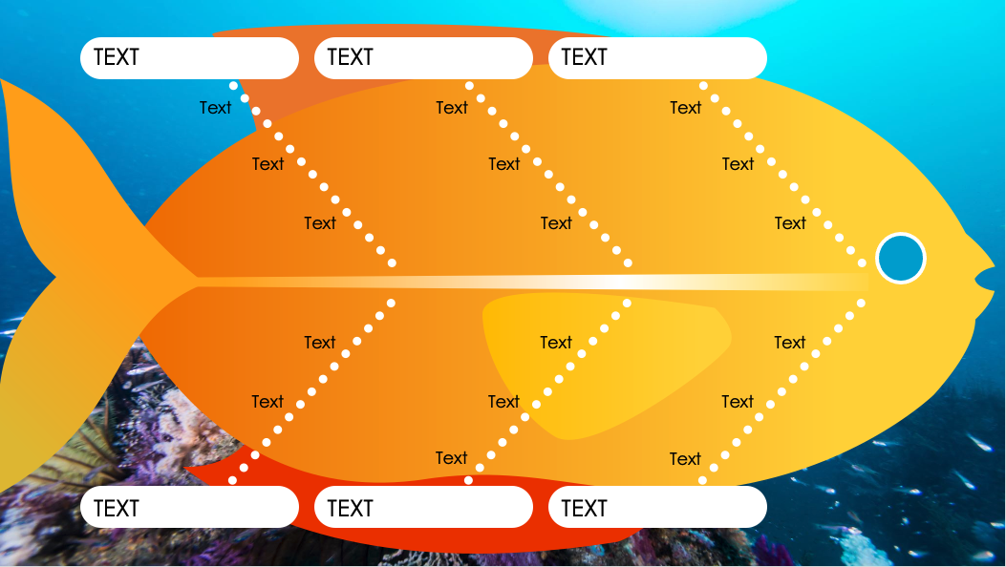
Full-Color Fishbone Diagram Template
When to Use This Template: This template is especially suited for presentations in environments that value creativity, such as marketing, education, or design settings. The template combines a root cause fishbone diagram with a visually engaging design, facilitating analysis and a dynamic presentation.
Notable Template Features: The vivid color palette ensures that each section is easily identifiable, which can help maintain the audience's attention and improve their ability to follow along with the analysis. The fish shape creatively embodies the fishbone concept, making it an inviting and memorable framework for problem-solving discussions.

Slide 2
TEXT
TEXT
TEXT
Text
Text
Text
Text
Text
Text
Text
Text
Text
Text
Text
Text
Text
Text
Text
Text
Text
TEXT
TEXT
TEXT

Slide 3
DISCLAIMER Any articles, templates, or information provided by Smartsheet on the website are for reference only. While we strive to keep the information up to date and correct, we make no representations or warranties of any kind, express or implied, about the completeness, accuracy, reliability, suitability, or availability with respect to the website or the information, articles, templates, or related graphics contained on the website. Any reliance you place on such information is therefore strictly at your own risk.

