Slide 1
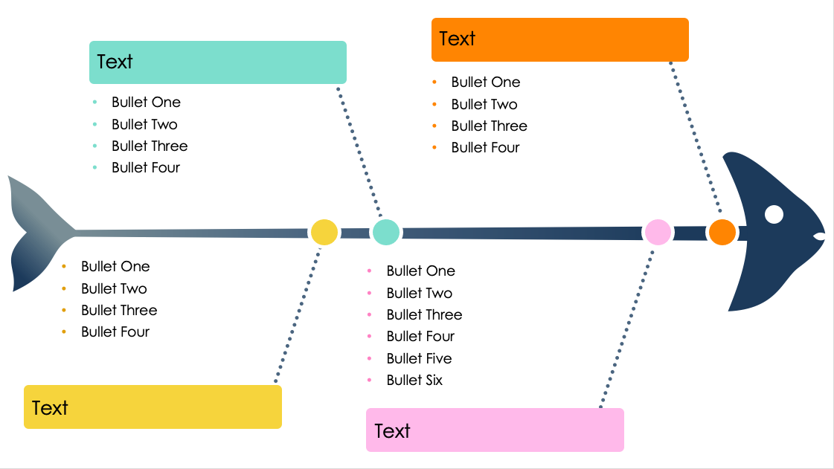
PowerPoint 4-Prong Fishbone Diagram Template
When to Use This Template: This template is ideal for planning sessions and business development meetings where a clear outline of key strategies is crucial. Executives and managers can communicate various strategic components to their teams, encouraging continuous quality improvement by focusing on actionable insights.
Notable Template Features: The streamlined, four-pronged approach to strategy analysis helps highlight key information while ensuring that the content is succinct. Brief descriptions allow presenters to convey a concise yet comprehensive overview of each strategic element. This clarity facilitates productive discussions on how different factors can influence the overall success of business initiatives.

Slide 2
Text
Text
Bullet One
Bullet Two
Bullet Three
Bullet Four
Bullet One
Bullet Two
Bullet Three
Bullet Four
Bullet One
Bullet Two
Bullet Three
Bullet Four
Bullet One
Bullet Two
Bullet Three
Bullet Four
Bullet Five
Bullet Six
Text
Text

Slide 3
DISCLAIMER Any articles, templates, or information provided by Smartsheet on the website are for reference only. While we strive to keep the information up to date and correct, we make no representations or warranties of any kind, express or implied, about the completeness, accuracy, reliability, suitability, or availability with respect to the website or the information, articles, templates, or related graphics contained on the website. Any reliance you place on such information is therefore strictly at your own risk.

