Slide 1
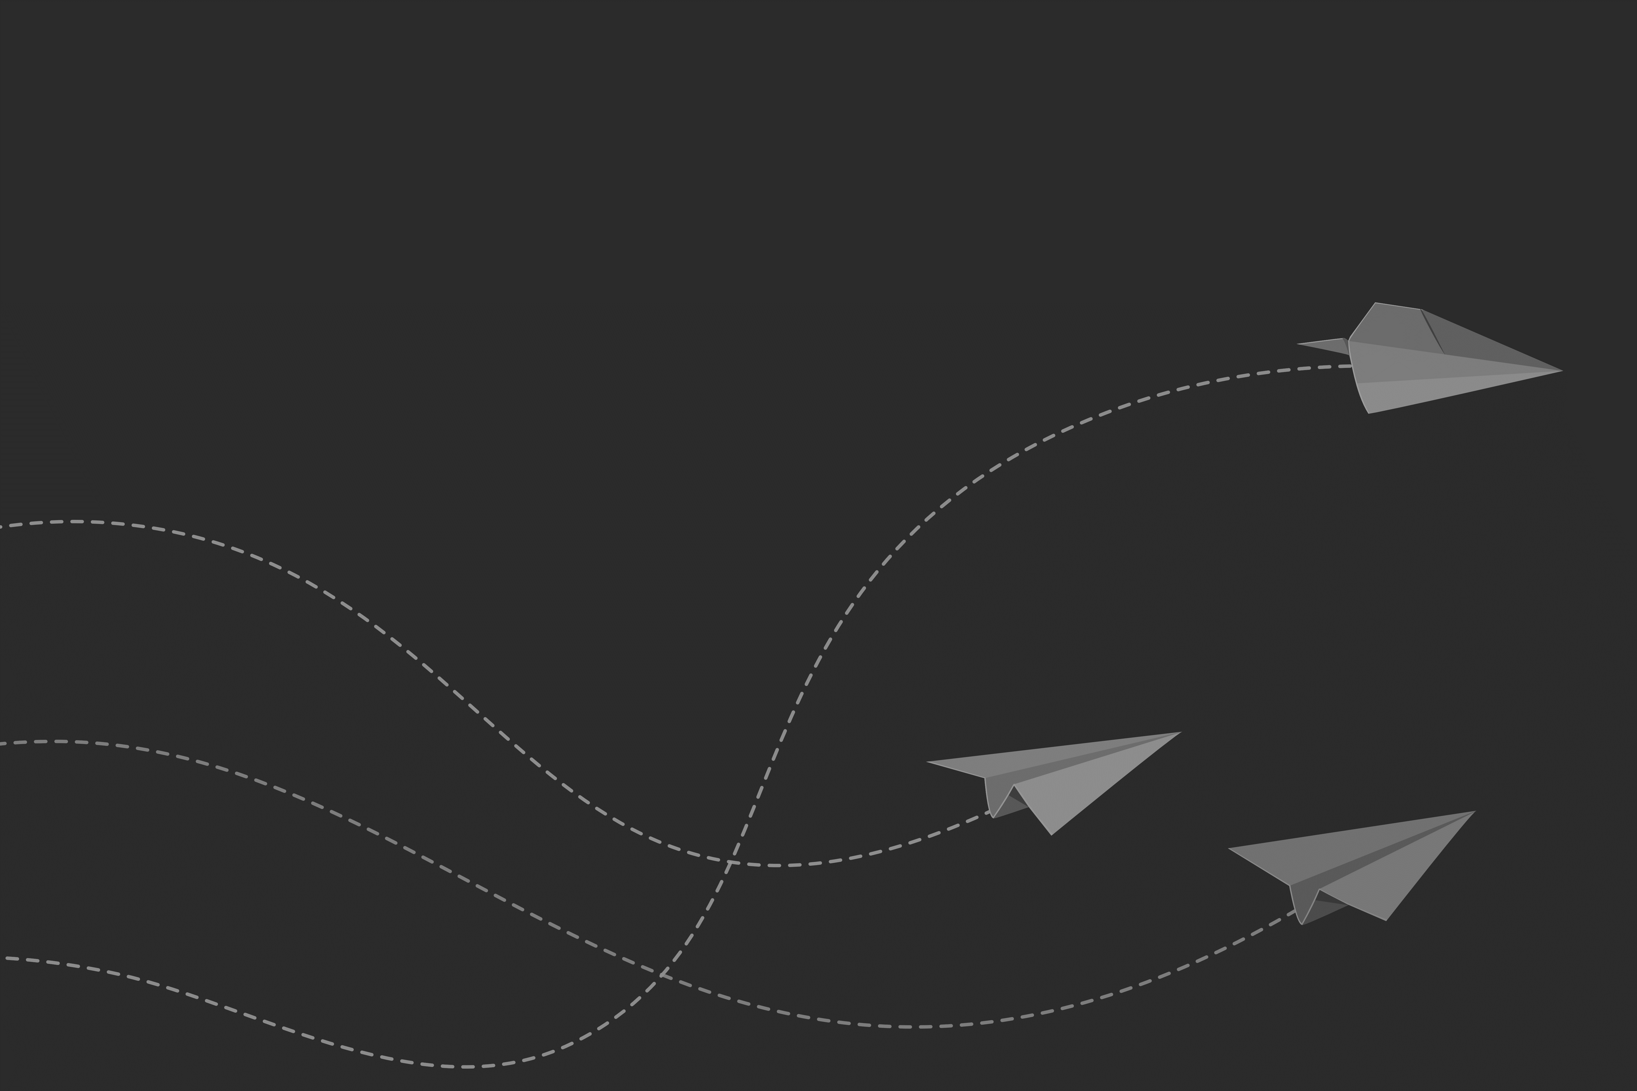
CUSTOMER JOURNEY CASE STUDY TEMPLATE FOR POWERPOINT
[ CASE STUDY NAME ]
CREATED BY
NAME
Date Created: MM/DD/YY

Slide 2
CASE STUDY
This template allows users to map out the entire customer journey: You can capture the actions, thoughts, and emotions at each stage; gain and present valuable insights into customer behavior; and show their experience with your product or service.
 | AWARENESS | INTEREST | DESIRE | PURCHASE | LOYALTY | CONSUMING | SHARING
DOING | Describe what actions the customer takes when they first become aware of your product/service. | Detail the customer's actions as they start showing interest in your product/service. | Explain the steps the customer takes when their interest evolves into a desire for your product/service. | Describe the customer's actions during the purchase process. | Explain how the customer shows loyalty to your brand or product. | Detail the customer's behavior when using your product/service. | Explain how and when the customer shares their experience with others.
THINKING | Outline the customer's thoughts or questions about your product/service at this stage. | Describe what the customer is considering or researching about your offering. | Share insights into the customer's mindset as they start desiring the product/service. | Outline the customer's considerations or decision-making process at this point. | Discuss what keeps the customer loyal or coming back. | Share thoughts or opinions the customer might have while using the product/service. | Describe the customer's motivations or thoughts behind sharing their experience.
FEELING | Explain the emotions the customer experiences upon discovering your product/service. | Illustrate the emotions or inclinations during their growing interest. | Highlight the emotional state associated with the increased desire. | Detail the emotions experienced during the purchase. | Describe the customer's emotional attachment or satisfaction leading to loyalty. | Highlight the customer's emotional experience during consumption. | Illustrate the emotions the customer feels when recommending or sharing about the product/service.

Slide 3
DISCLAIMER Any articles, templates, or information provided by Smartsheet on the website are for reference only. While we strive to keep the information up to date and correct, we make no representations or warranties of any kind, express or implied, about the completeness, accuracy, reliability, suitability, or availability with respect to the website or the information, articles, templates, or related graphics contained on the website. Any reliance you place on such information is therefore strictly at your own risk.

