Slide 1
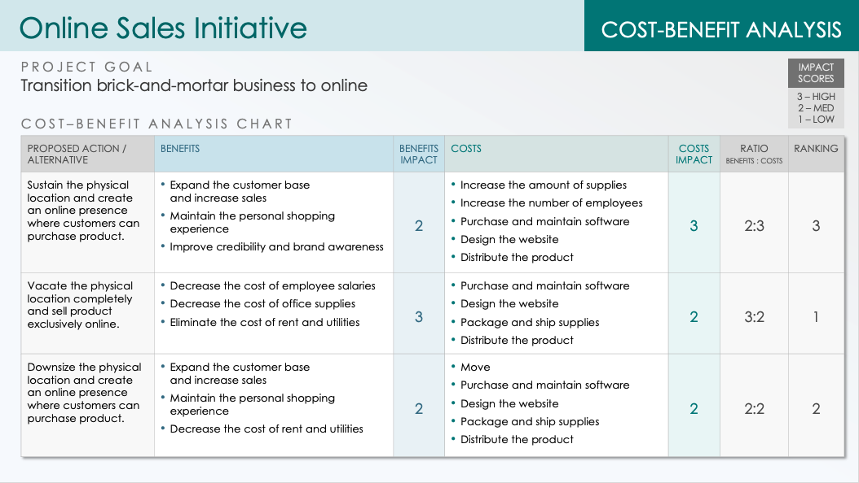
Cost-Benefit Analysis Template for PowerPoint
This cost-benefit analysis example template, available with or without sample data, allows you to compare the economic feasibility of your proposed project to that of alternative options. List the benefits of each option. Then rank its impact as high, medium, or low. Do the same with the costs. Use the ratio column to show the weighted proportion between the benefits and the costs. Share this slide with stakeholders to help determine which option is the best.

Slide 2
Project Title
COST-BENEFIT ANALYSIS
PROJECT GOAL
IMPACT SCORES
Enter a brief description of the project
3 – HIGH
2 – MED
1 – LOW
COST–BENEFIT ANALYSIS CHART
PROPOSED ACTION / ALTERNATIVE | BENEFITS | BENEFITS IMPACT | COSTS | COSTS IMPACT | RATIO BENEFITS : COSTS | RANKING
 | Benefit One |  | Cost One Cost Two
 | Benefit One Benefit Two |  | Cost One
 | Benefit One |  | Cost One

Slide 3
EXAMPLE: Online Sales Initiative
COST-BENEFIT ANALYSIS
PROJECT GOAL
IMPACT SCORES
Transition brick-and-mortar business to online
3 – HIGH
2 – MED
1 – LOW
COST–BENEFIT ANALYSIS CHART
PROPOSED ACTION / ALTERNATIVE | BENEFITS | BENEFITS IMPACT | COSTS | COSTS IMPACT | RATIO BENEFITS : COSTS | RANKING
Sustain the physical location and create an online presence where customers can purchase product. | Expand the customer base and increase sales Maintain the personal shopping experience Improve credibility and brand awareness | 2 | Increase the amount of supplies Increase the number of employees Purchase and maintain software Design the website Distribute the product | 3 | 2:3 | 3
Vacate the physical location completely and sell product exclusively online. | Decrease the cost of employee salaries Decrease the cost of office supplies Eliminate the cost of rent and utilities | 3 | Purchase and maintain software Design the website Package and ship supplies Distribute the product | 2 | 3:2 | 1
Downsize the physical location and create an online presence where customers can purchase product. | Expand the customer base and increase sales Maintain the personal shopping experience Decrease the cost of rent and utilities | 2 | Move Purchase and maintain software Design the website Package and ship supplies Distribute the product | 2 | 2:2 | 2

Slide 4
DISCLAIMER Any articles, templates, or information provided by Smartsheet on the website are for reference only. While we strive to keep the information up to date and correct, we make no representations or warranties of any kind, express or implied, about the completeness, accuracy, reliability, suitability, or availability with respect to the website or the information, articles, templates, or related graphics contained on the website. Any reliance you place on such information is therefore strictly at your own risk.

